Slide 1

School Name Review Update
July 13, 2023
Karen Waters
Director of Community Education
Project Manager, School Name Review
Notes:
Good evening, I’m Karen Waters, Director of Community Education. I am here in my role as the superintendent’s designee to act as Project Manager for School Name Reviews. Thank you for allowing me to update you on out progress.

Slide 2
School Board Directive to the Superintendent
On October 25, 2018, the School Board directed the Superintendent to:
Add school division values to the criteria for naming school buildings and facilities.
Review the names of all schools in the division named after individuals, and how faithful those designations are to the values of our school division.
Report recommendations to the Board for changing the names of schools that are inconsistent with our values.
Notes:
As you know, in 2018, the Board directed the Superintendent to review all names of schools named after individuals to ensure alignment with our values, which are found in our strategic plan.

Slide 3



Strategic Plan: Learning for All
VISION
VALUES
Our learners are engaged in authentic, challenging, and relevant learning experiences, becoming lifelong contributors and leaders in our dynamic and diverse society.
Equity
Excellence
Family and Community
Wellness
MISSION
GOALS
Working together as a team, we will end the predictive value of race, class, gender, and special capacities for our children’s success through high-quality teaching and learning for all. We seek to build relationships with families and communities to ensure that every student succeeds.
We will know every student.
Thriving Students
Affirming and Empowering Communities
Equitable, Transformative Resources
Notes:
In addition to ensuring alignment with Equity, Excellence, Family and Community and Wellness, we want to maintain fidelity to our Anti-Racism policy.

Slide 4

ACPS Anti-Racism policy
Albemarle County School Board Policy ACC Anti-Racism states “The Albemarle County School Board (“Board”) and the Albemarle County Public Schools (“Division”) reject all forms of racism as destructive to the Division’s mission, vision, values, and goals.”

Slide 5
Individual Racism
Is pre-judgment, bias, or discrimination by an individual based on race. Individual racism includes both privately held beliefs, conscious and unconscious, and external behaviors and actions towards others.

Slide 6

Institutional Racism
Occurs within institutions and organizations, such as schools, that adopt and maintain policies, practices, and procedures that often unintentionally produce inequitable outcomes for people of color and advantages for white people.

Slide 7
Systemic/Structural Racism
Encompasses the history and current reality of institutional racism across all institutions and society -- It refers to the history, culture, ideology, and interactions of institutions and policies that perpetuate a system of inequity that is detrimental to communities of color.

Slide 8
Past School Name Reviews: School Board Actions
Paul H. Cale Elementary ➤ Mountain View Elementary
Mortimer Y. Sutherland Middle ➤ Lakeside Middle
Virginia L. Murray Elementary ➤ Virginia L. Murray Elementary
Charter Public School ➤ Community Lab School
Jack Jouett Middle ➤ Journey Middle
Broadus Wood Elementary ➤ Broadus Wood Elementary
Mary Carr Greer Elementary ➤Mary Carr Greer Elementary
Meriwether Lewis Elementary School ➤ Ivy Elementary
Notes:
Since beginning this process, the names of 3 schools have been retained, with 5 being renamed, the most recent being Ivy Elementary as of July 1.

Slide 9
Staff Research/Recommendation ➤Board Directive
School
Name Review
Process Changes
Upon direction from the Superintendent, a staff designee shall (a) provide research to the School Board about the individual for whom the school is named so that the School Board may determine whether the existing school name aligns with the current vision, mission, and values of the School Board; and (b) present a recommendation to the School Board as to whether the current name should retained or changed.
Board Directive ➤ Retention or Review
The School Board will determine whether to retain the current name or rename the school. Names of individual(s) will not be considered in the renaming process.
Name Review ➤ Community Process
Advisory Committee, Surveys, Public Meetings
Notes:
Recently, you have made changes to the Name review policy, which require staff to provide you with research on the individuals for whom our schools are named, along with a recommendation to retain or implement a review for your consideration. Should you determine you would like to initiate a name review, that school’s name will be changed,and will no longer be named for a person. A new name will be determined via a community engagement process utilizing an advisory committee, surveys and public meetings.

Slide 10
Remaining Schools for Review
1
Baker-Butler Elementary
Agnor-Hurt Elementary
Stone-Robinson Elementary
3/
5
Named in 2002 after 1st African-American ACPS School Board Chair John E. Baker (1932-2015) and 1st African-American Board of Supervisors member James R. Butler (-2003)
Opened in 1992; Named after County Executive Guy B. Agnor Jr. (1929-1996) and AHS Principal Benjamin Hurt (1918-2018)
Founded in 1961 the school was named Stone-Robinson by a committee of citizens after Mary L. Stone, matriarch of the family upon whose land the previous school was situated, and Rev. Frank L. Robinson, rector of Grace Episcopal Church.
Jackson P. Burley Middle
Leslie H. Walton Middle
6
Opened as a High School for Blacks in 1951, the school was named for a prominent African-American businessman whose property was taken by eminent domain to build the school It was renamed Jackson P. Burley Middle School when acquired by ACPS as a middle school in 1974.
2
Joseph T. Henley Middle
4
6
Founded in 1974. The school was named for Reverend Leslie H. Walton, an ACPS Superintendent.
Named in honor of Albemarle County School Board Chairman and former Supervisor Joseph Temple Henley, Jr. (1928- 2011) in 1996.

Slide 11
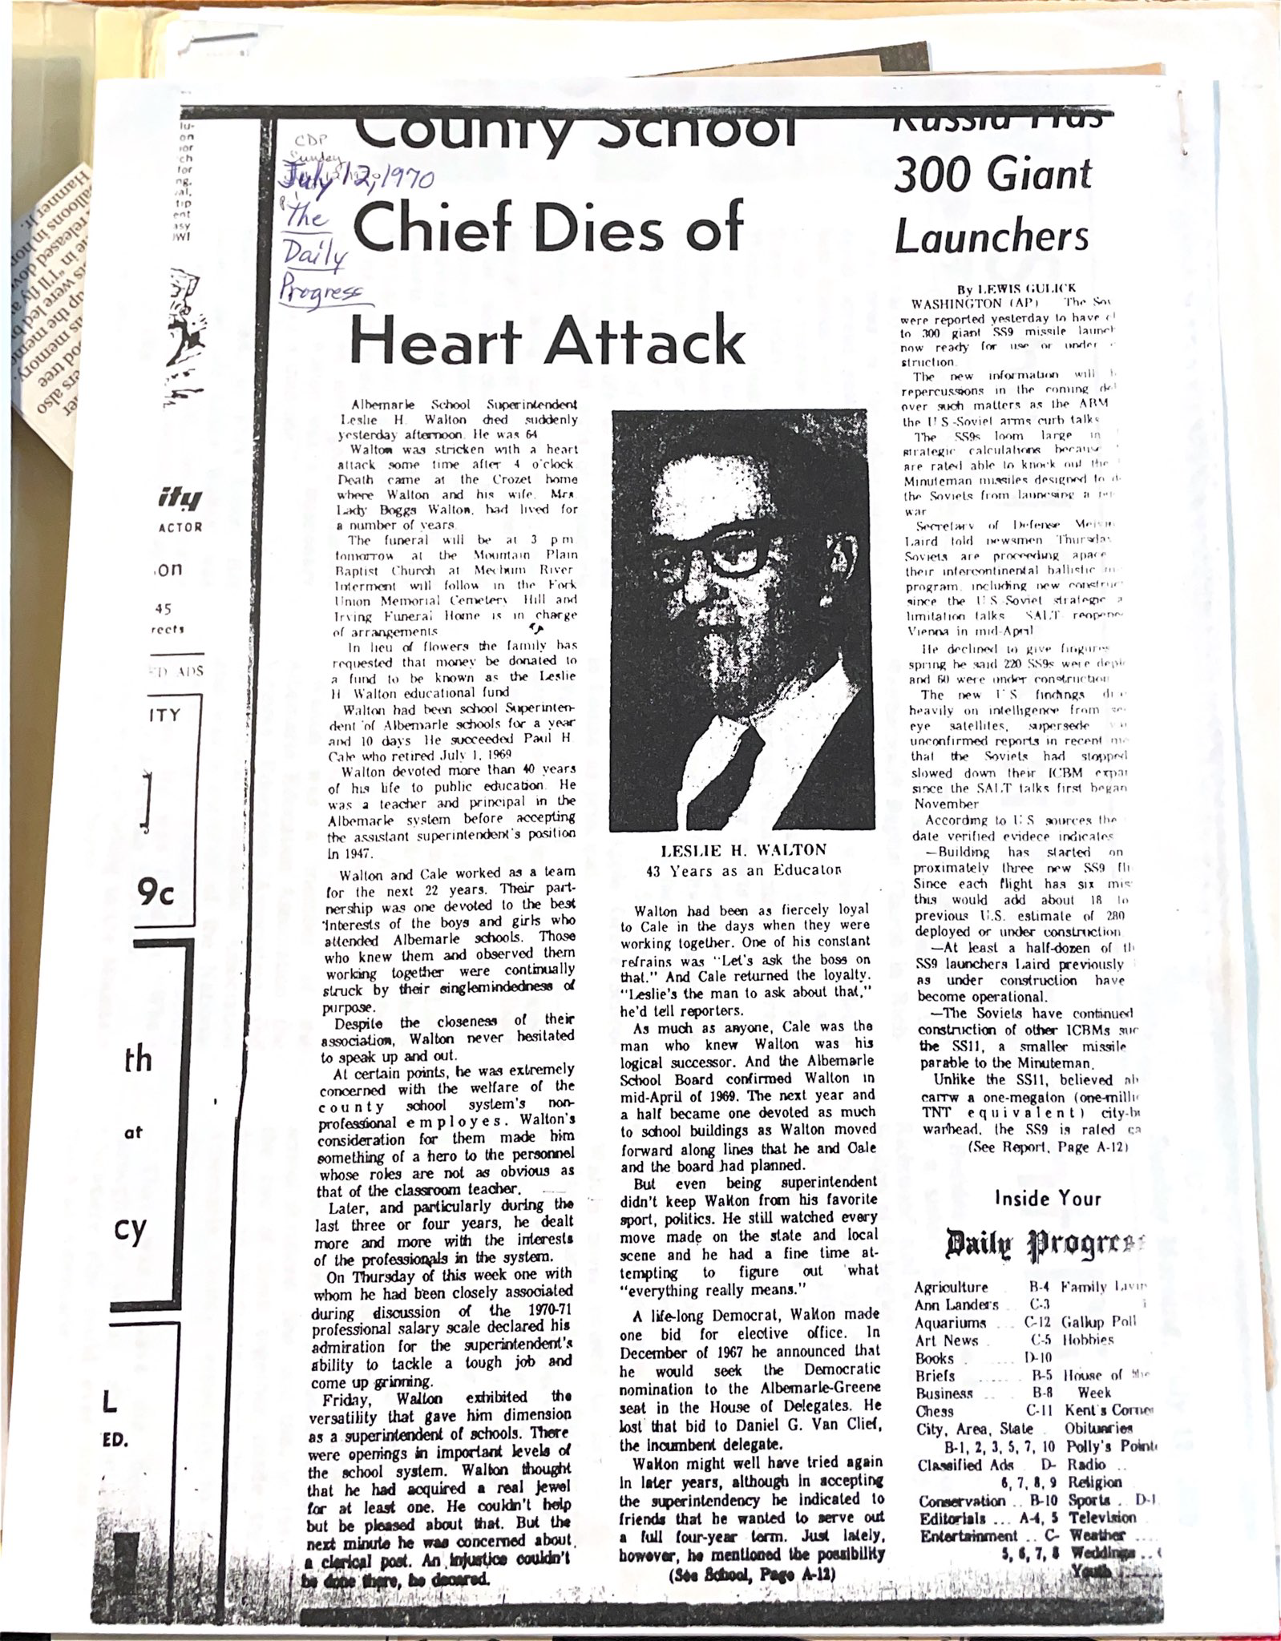
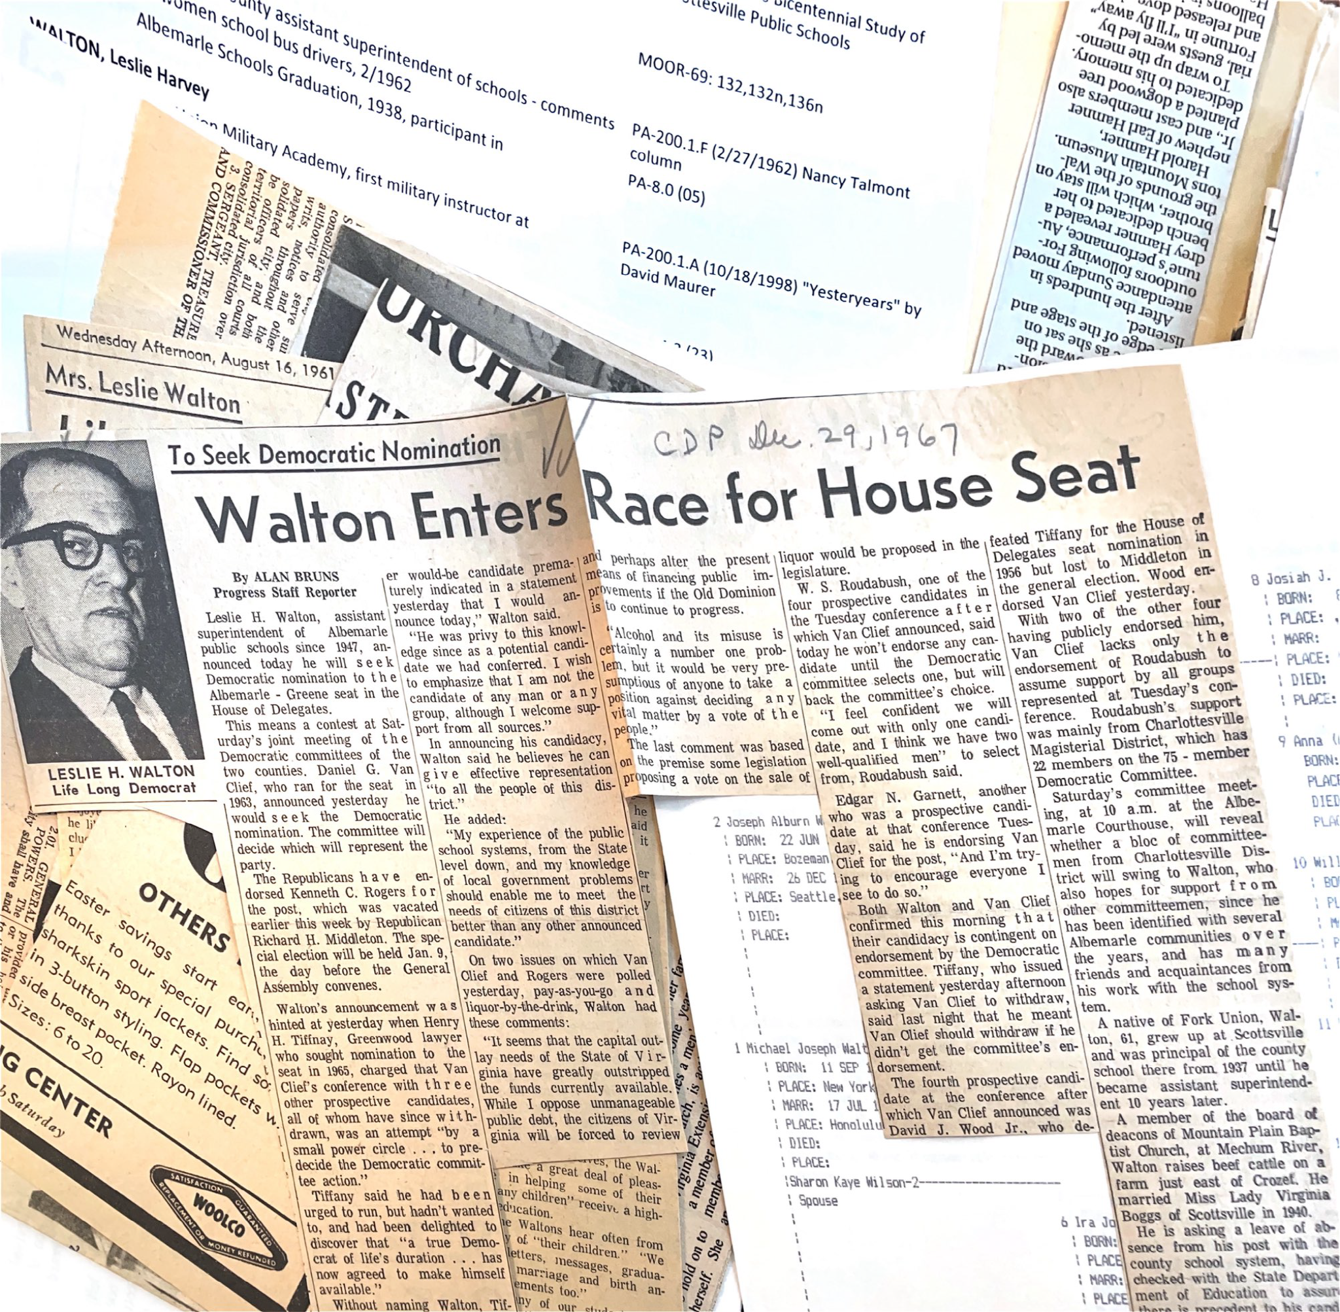
Sources
Daily Progress
Interviews
Obituaries
School Board Minutes
Scottsville Museum
Board of Supervisors Minutes
Yearbooks
Albemarle-Charlottesville Historical Society
Albemarle’s Black Classrooms-Lorenzo Dickerson
School Board commissioned research by Shelly Murphy, Jean L. Cooper and April Burns

Slide 12
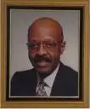
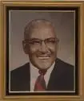
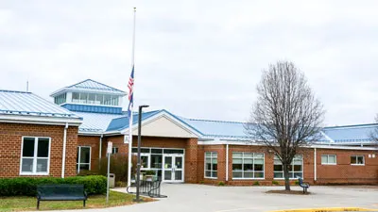
Baker-Butler Elementary
Built in 2002, named after John E. Baker and James R. Butler by a committee empaneled by Superintendent.
John Baker (1932-2005), a retired Army Lt. Col., and former Community College Vice-President, was the first black elected member and Chair of the ACPS School Board. He served on a number of boards and committees and was recognized for his service to the community by the Virginia General Assembly in 2006.
James R. Butler (1914-2003), was the first African-American Executive Director of an Extension Office and was the first Black elected to the County Board of Supervisors He was instrumental in establishing CATEC and recognized by the General Assembly for his contributions to many organizations upon his death.
A review commissioned by the ACPS school board and conducted by Murphy et. al., indicated “no quotes or articles that seem to be problematic.”
This name is consistent with ACPS values of Equity, Excellence, Family and Community, Wellness and is recommended for RETENTION.
Est. 2002
Notes:
Baker-Butler Elementary was built in 2002, and was named by an advisory committee empaneled by the Superintendent at the time. It is named after John Baker, the first black elected member and Chair of the School board, and James Butler, the first Black man elected to the board of supervisors. Both men were deeply involved in the community and were separately recognized by the general assembly upon their deaths.

Slide 13
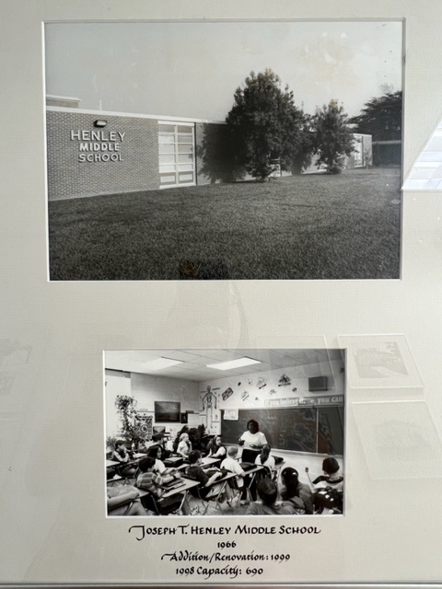
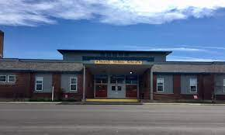
Joseph T. Henley Middle
Henley Middle School opened on September 6, 1966, and was named after ACPS School Board Chair and farmer, Joseph Temple Henley Sr., although many sources indicate it was named for his son, Joseph T. Henley Jr.
Joseph T. Henley Sr. (1901-1960) was a farmer who began Henley’s Orchard and Holly Hill Farm in Crozet in 1932. Active in local politics, he chaired the ACPS school board from 1946-1960, where he continuously served on the Burley Committee ensuring continuous, though segregated education for non-white students, and continued to keep Virginia Murray on payroll upon discovery of her brain tumor. A resolution was passed in her honor upon her death. In 1951, he challenged Sen. E.O. McCue for his seat and lost. He was killed in a farming accident and the chairmanship of the school board passed to EJ Oglesby. Within 3 years of the absence of his leadership, the Board of Supervisors fired the entire board after they created a policy to cancel all athletics and activities if forced to integrate schools.
While his tenure with the school board encompassed a very difficult time in ACPS history, research commissioned by the school board by Murphy et al indicated they “found nothing that seems problematic.”
Joseph Temple Henley, Jr. (1928-2011) served on the Albemarle County Board of Supervisors representing the White Hall District for 16 years. He took over the family business and was named Outstanding Farmer of the Year for Albemarle County in 1961. A father of four married for 60 years, He was a member of the White Hall Ruritan Club, Crozet Sportsman Club, Tuesday Night Supper Club, and was a life-long member of Crozet United Methodist Church acting as Sunday School Teacher, Pastor-Parish Relations Committee Chairman, Trustee, and member of the CUMC Men’s Club.
This name is consistent with ACPS values of Equity, Excellence, Family and Community, Wellness and is recommended for RETENTION.
Est. 1966
Notes:
Joseph T. Henley Middle School was opened on Sept. 6, and while several sources indicated that it was named for County Supervisor Joseph Henley Jr., it was actually named after his father, Joseph Sr., who chaired the school board from 1946-1960. Consequently, I have researched both gentlemen. Joseph Sr. was a farmer, and started Henley’s Orchard and Holly Hills Farm back in 1932. During his service on the school board, he was a constant presence on the committee formed to build Burley, and remained committed to Burley during his entire tenure, helping to ensure continuous, though segregated education for non-white county students. Under his leadership, pay was continued for Mrs. Virginia Murray when she became ill with a brain tumor, and a resolution was passed by the board upon her death. In 1951, he unsuccessfully challenged Sen. E.O. McCue who was a documented segregationist and fought to restrict the construction of public housing for his seat in a primary. When Mr. Henley was killed in a farming accident, the chairmanship of the school board passed to E.J. Oglesby, and the tenor and focus of the board minutes underwent a marked shift. Within 3 years of his absence, the board of supervisors fired the entire school board after they created a resolution to cancel all athletics and activities if schools were forced to integrate, and refused the supervisors’ request to rescind it. Joseph Jr. served on the board of supervisors for 16 years, continued the family business and was active in church and the community. A review commissioned by the board indicated nothing problematic with these individuals. This name is consistent with our values, and is recommended for retention.

Slide 14
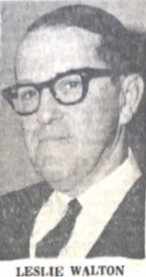
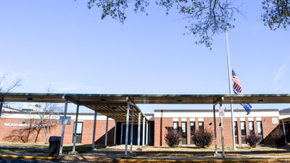
Leslie Hughes Walton Middle
Opened in 1974, the school was named after ACPS School Board Chair Leslie Hughes Walton, who died of a heart attack one year into his term. Some sources incorrectly identify his father, Rev. Leslie Harvey Walton as the namesake.
Leslie Hughes Walton (1906-1970) was born in Fork Union. His father was Reverend Leslie Harvey Walton (Scottsville Baptist Church). He married Lady Boggs in 1940. Known as a “Lifelong Democrat” he unsuccessfully ran for statewide office in 1967. Walton taught at Greenwood School early in his career, was the principal of Scottsville High School, served as Clerk of the School Board and took the role of Assistant Superintendent in 1947, working closely with his best friend, Paul Cale. On Cale’s retirement in 1969 he became Superintendent. According to the Daily Progress on July 12, 1970, “Those who knew them and observed them working together were continually struck by their singlemindedness of purpose.”
Additional RESEARCH is required to determine whether this name is consistent with ACPS values.
Est. 1974

Slide 15
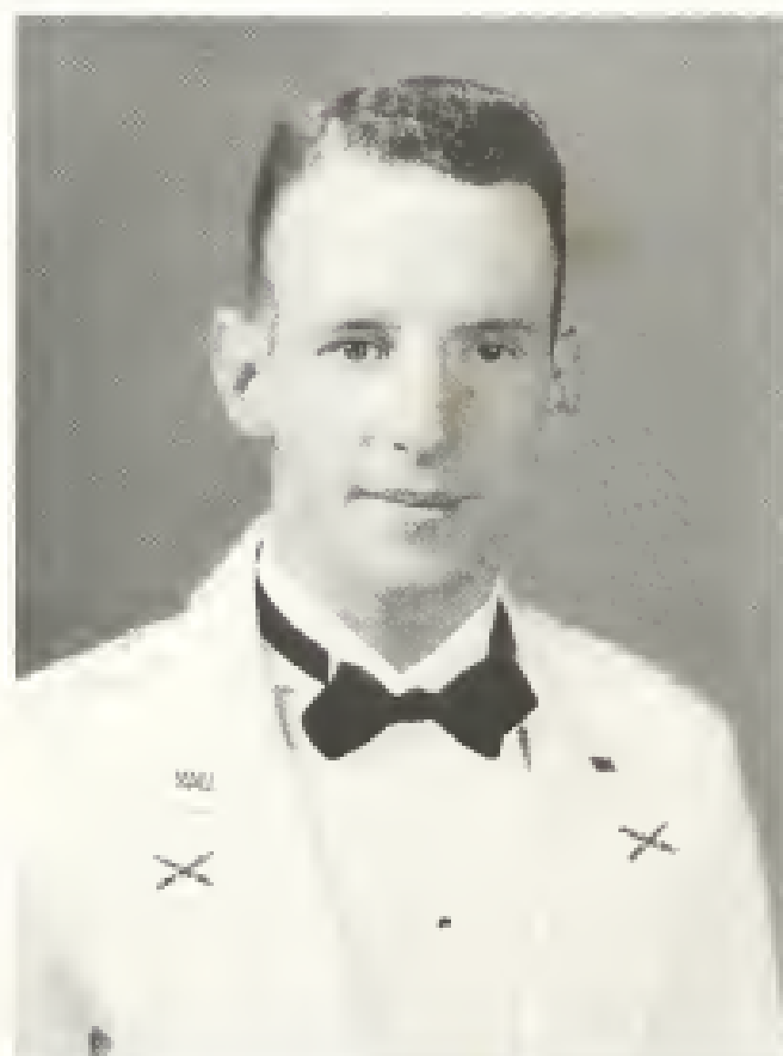
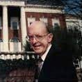
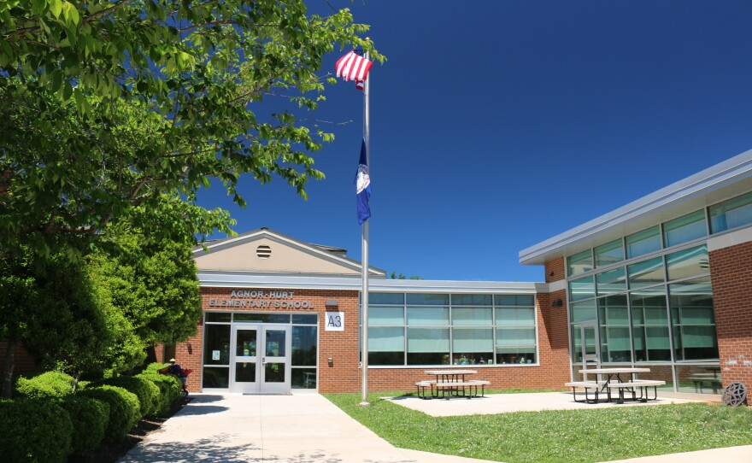
Agnor-Hurt Elementary
Agnor-Hurt was opened in 1992 and was named in honor of former county executive Guy Agnor Jr. and Albemarle educator and principal Benjamin Franklin Hurt. In addition to Agnor-Hurt, the drive leading to AHS is named for Hurt.
Guy B. Agnor Jr. (1929-1996) was County Executive from 1976-1990. Originally from Lexington VA, he graduated from VMI 1951. After serving as a Captain in the Army, he worked briefly in his family’s oil business, taught at VMI, and was City Manager for the City of Lexington from 1966 to 1972. He became Public Works Director in Charlottesville in 1972. A father of four, he was active at the Senior Center and First United Methodist Church and received the Paul Goodloe McIntire Award from the Charlottesville Albemarle Chamber of Commerce for outstanding community leadership.
A review commissioned by the ACPS school board and conducted by Murphy et. Al indicated “A review of this individual found no quotes or articles that seem problematic.”
Est. 1992

Slide 16
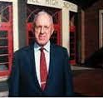
Agnor-Hurt Elementary
Agnor-Hurt was opened in 1992 and was named in honor of former county executive Guy Agnor Jr. and Albemarle educator and principal Benjamin Franklin Hurt. In addition to Agnor-Hurt, the drive leading to AHS is named for Hurt.
Benjamin Franklin Hurt (1918-2018) was principal of Albemarle High School from 1954-1984 and was elected to the VHSL Hall of Fame. Prior to that, he served as a teacher, coach and principal at Greenwood High School. He received a degree in Latin at Hamden-Sydney and Master’s degree in education at UVA. During WWII, he served four years in the U.S. Army. He was a member of Crozet Baptist Church. He was also a member of the Crozet Lions Club for 70 years. Nationally, minstrel shows are a well-documented form of entertainment and fundraising historically utilized by Lions Clubs. During his tenure at AHS, the Booster Club’s annual fundraising minstrel shows and were pictured in the school’s yearbooks, along with other images that can be seen as troublesome by current standards. Upon his death, Mr. Hurt was highly lauded and honored by many.
Additional RESEARCH is required to determine whether this name is consistent with ACPS values.
Est. 1992

Slide 17
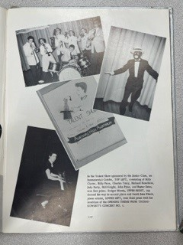
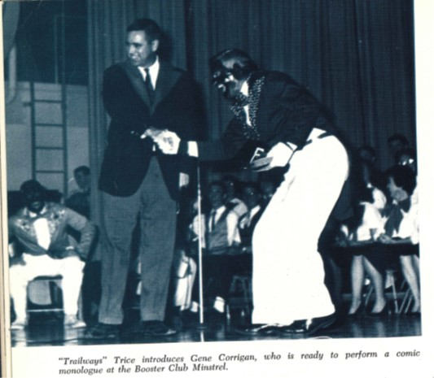
AHS Peer 1963-68

Slide 18
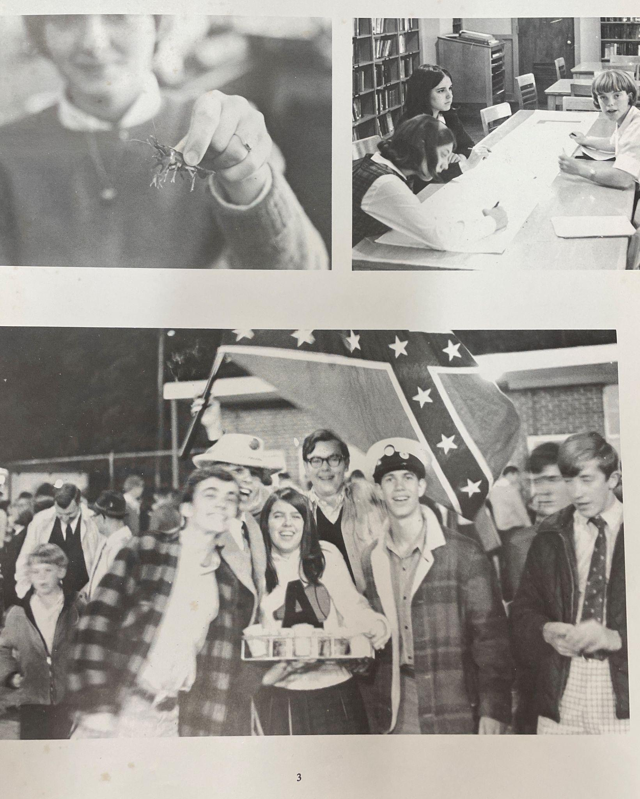
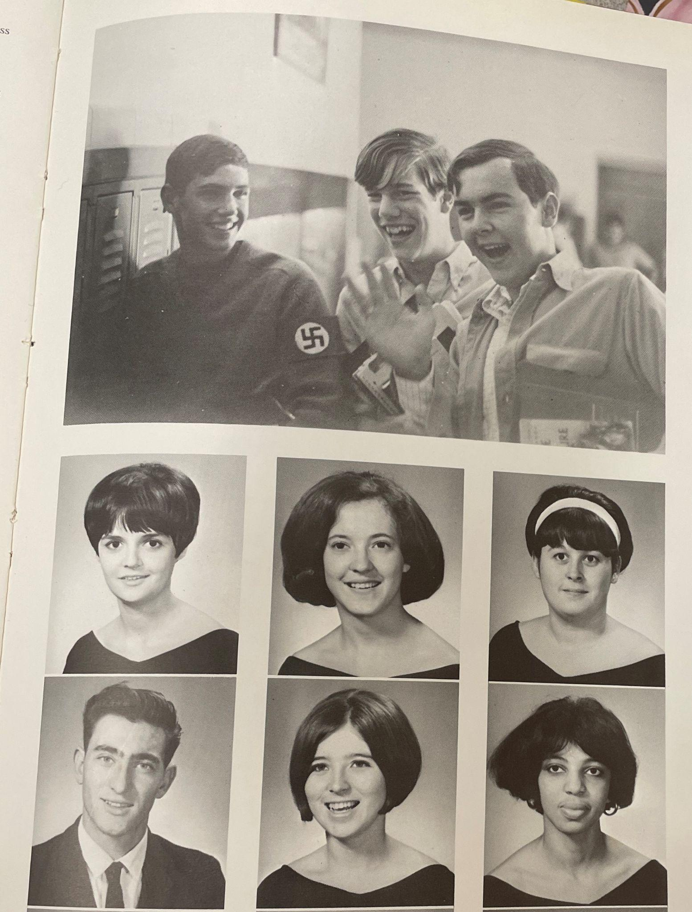

Slide 19
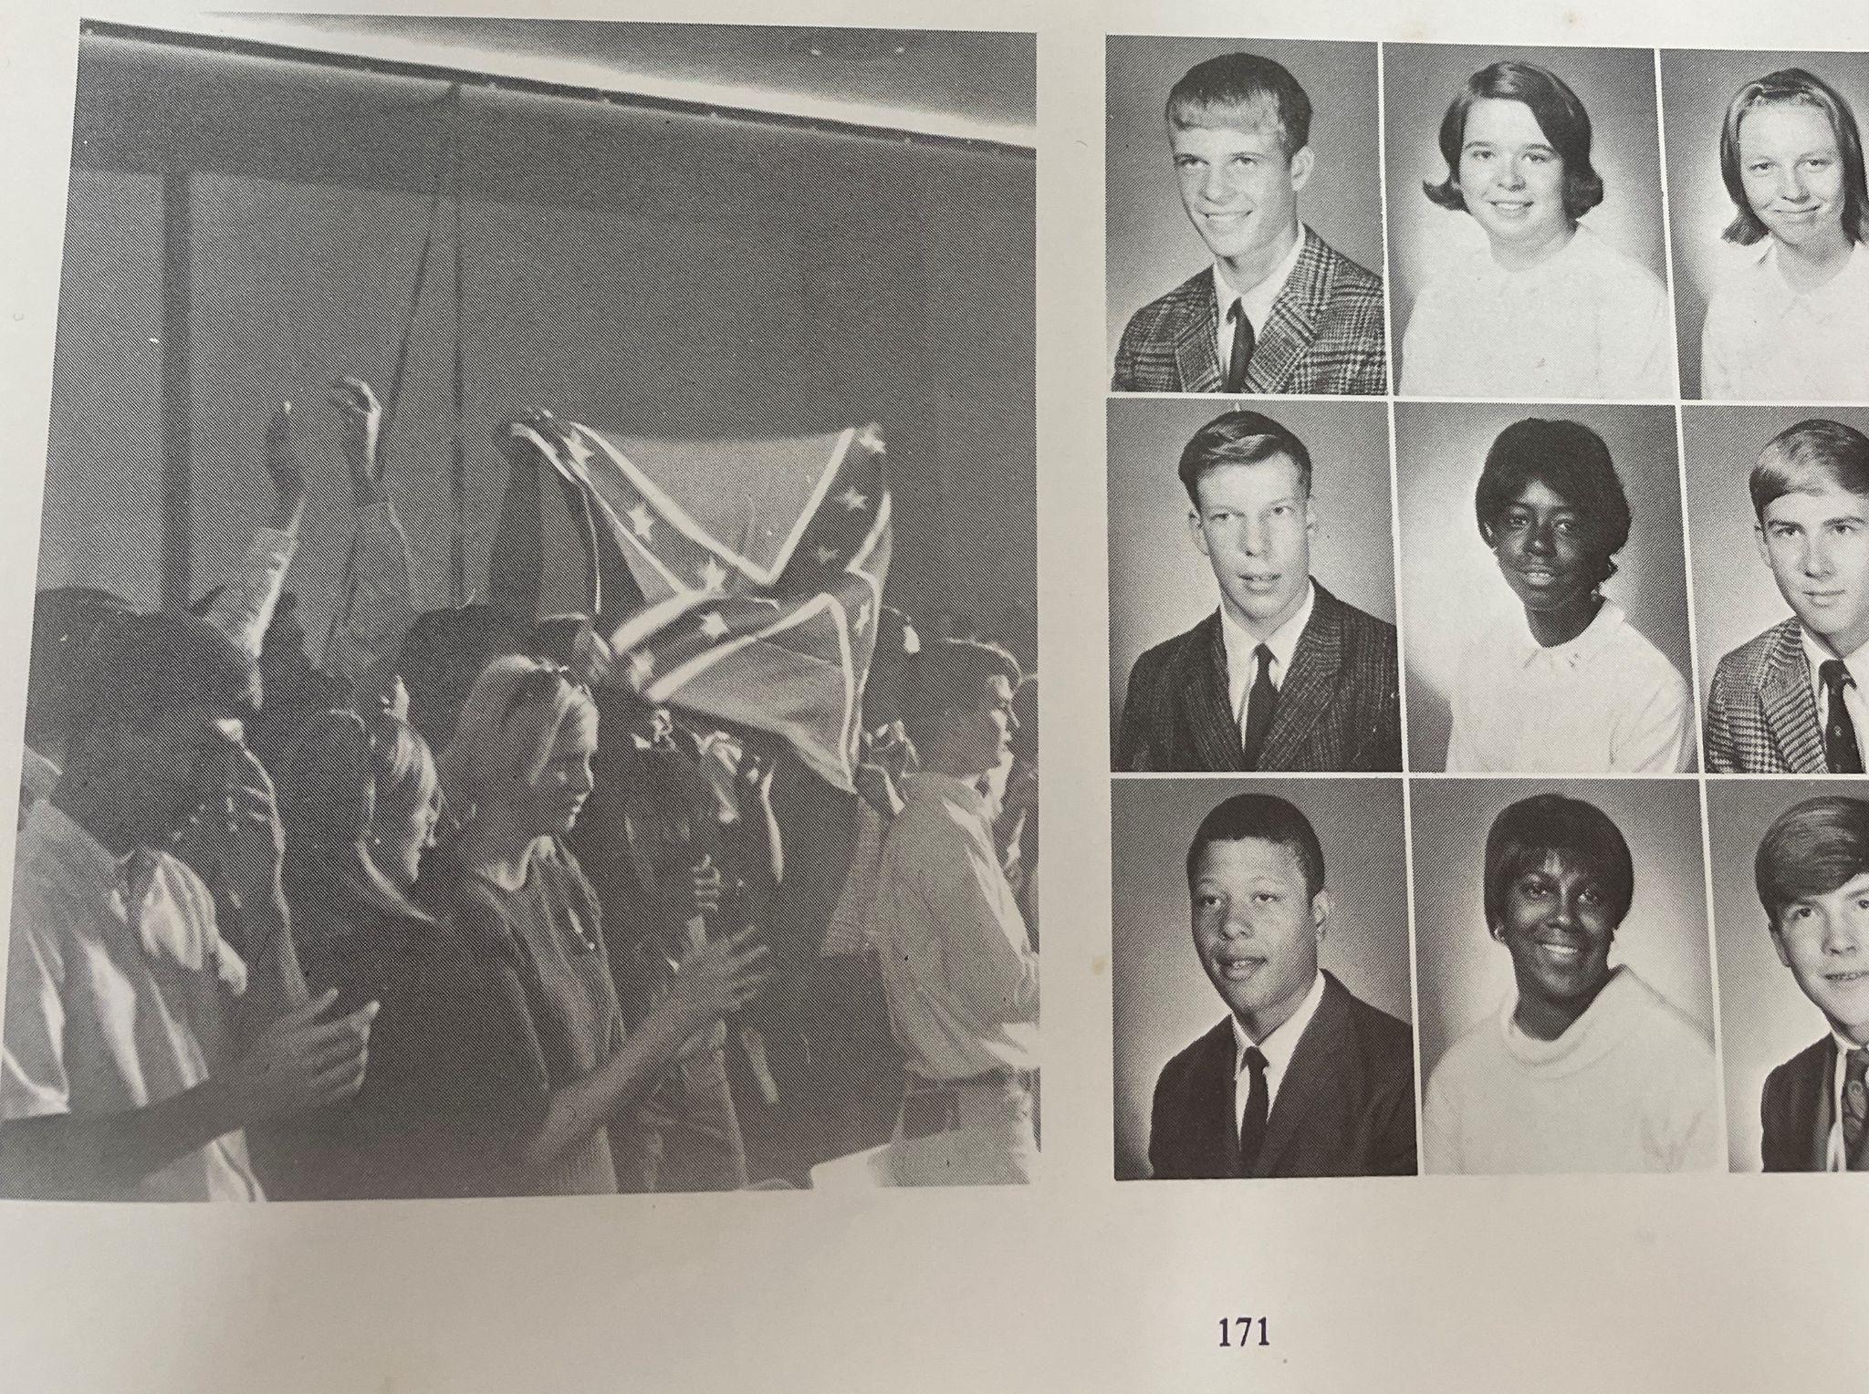

Slide 20
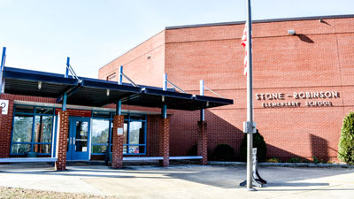
Stone-Robinson Elementary
Stone-Robinson Elementary School was created in 1961 when two smaller schools, Overton and Cismont were consolidated. A committee of citizens agreed that the school would be named for both Mary L. Stone and Rev. Leslie Robinson. The school remained segregated until 1966.
Mary L. Stone (1873-1940) was the matriarch of the Stone family of Morven, on which the Overton School was located. She was very active in the Garden Club and frequently shared the grounds and gardens with local school children. In her later years she would serve the community as a librarian.
Rev. Frank L. Robinson (1874-1960) was the rector at Grace Church in Keswick from 1910. He took a great interest in the Cismont School, visiting regularly. He married Mabel Graeme Farrish, and they had one son, Francis Leslie Robinson, Jr.
A review commissioned by the ACPS school board and conducted by Murphy et. al, indicated neither of these individuals were actively involved in schools and revealed no quotes or articles out of line with ACPS values.
This name is consistent with ACPS values of Equity, Excellence, Family and Community, Wellness and is recommended for RETENTION.
Est. 1961

Slide 21
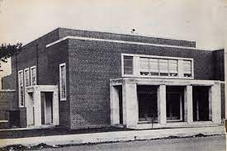
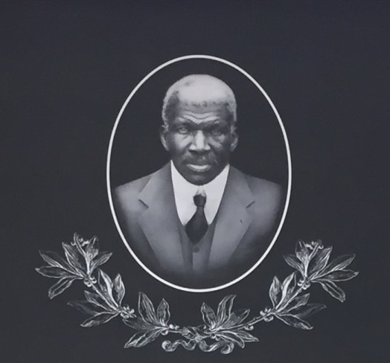
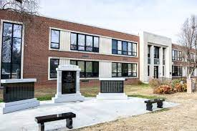
Jackson P. Burley Middle
Est. 1974
Opened as a joint City/County High School for Blacks in 1951, the school was named for a prominent African-American businessman whose property was condemned and then purchased by the city over the objection of his widow to build the school It was renamed Jackson P. Burley Middle School when acquired by ACPS as a middle school in 1974.
Jackson P. Burley (1929-1996) According to the Daily Progress, June 2, 1950, Burley was a native of Albemarle County born in 1863. He studied at Hampton Institute and following his graduation began his long career as a teacher. He later moved back to Albemarle County, and taught agriculture at the Albemarle Training School for nineteen years before retiring in 1937 As a life-long educator and community leader, the committee agreed that it was most fitting to name the new high school for him. It was also appropriate as most of the land where Burley stands had belonged to Jackson P. Burley and his family.
This name is consistent with ACPS values of Equity, Excellence, Family and Community, Wellness and is recommended for RETENTION.

Slide 22
Recommendation
RETAIN
RESEARCH
REVIEW
Baker-Butler Elementary
Stone-Robinson Elementary
Jackson P. Burley Middle
Joseph T. Henley Middle
Agnor-Hurt Elementary
Leslie H. Walton Middle
To be determined by School Board

